Slide 1
Design Patterns
Adapter Patterns

Slide 2
Adapter Pattern
GoF Intent: “Converts the interface of a class into another interface the clients expect. Adapter lets classes work together that couldn’t otherwise because of incompatible interfaces.”
Also known as a “Wrapper”

Slide 3
Real Life Examples
Vendor Classes
  Grid Control
  FTP Utility
  Email Utility

Slide 4
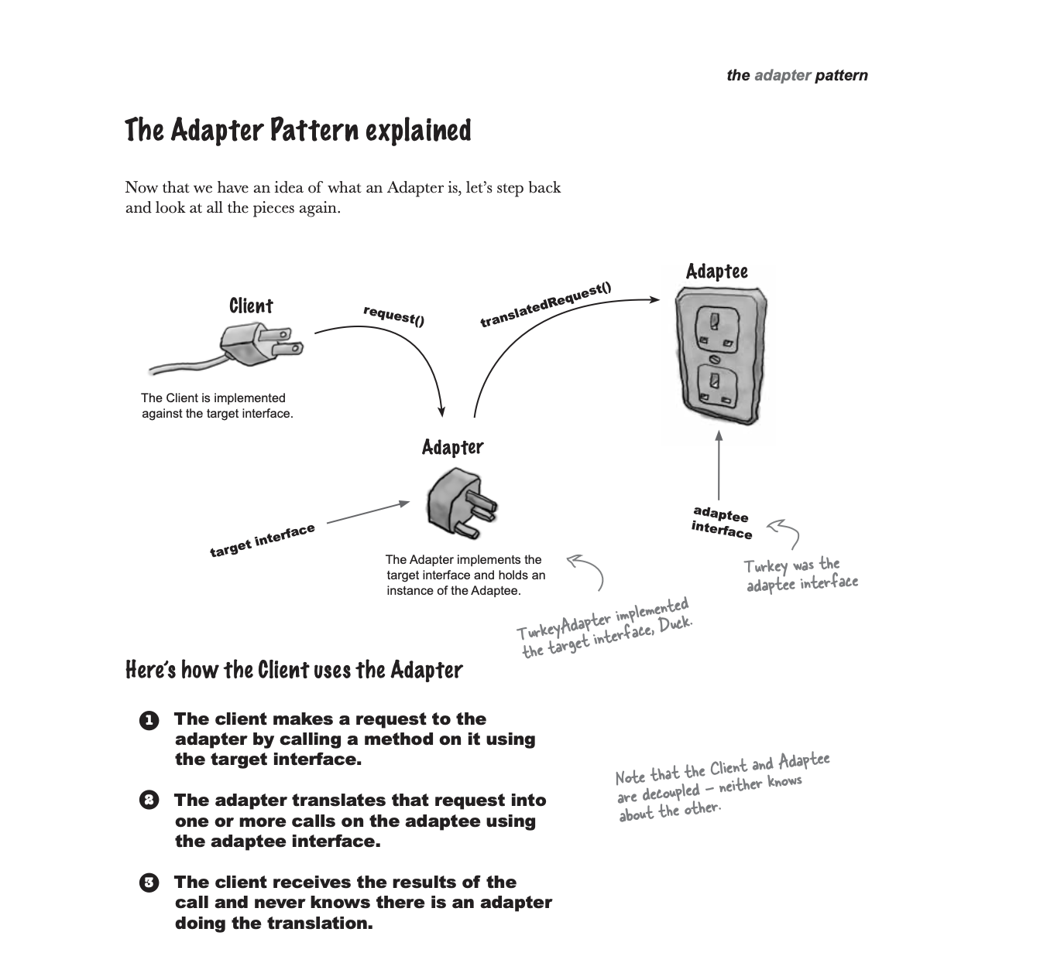

Slide 5
Drawback
If you have Grid control with 20 methods…you may need to create an Adapter with 20 methods that all direct to the grid method.
Thus..a lot of extra code!

Slide 6
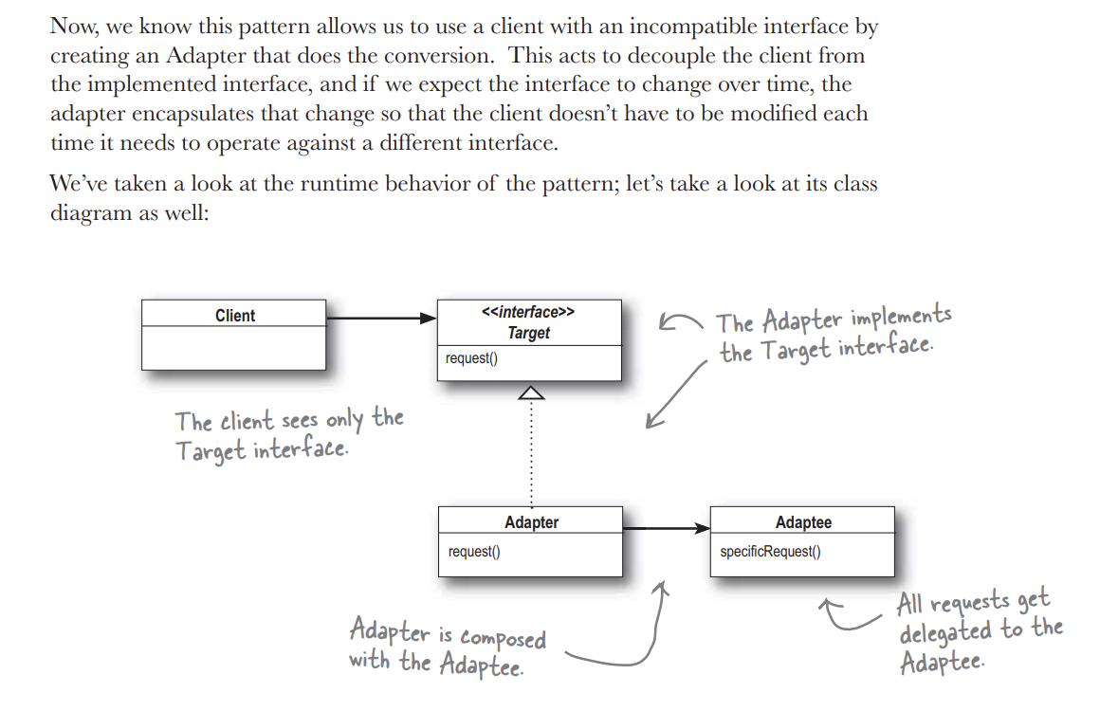

Slide 7
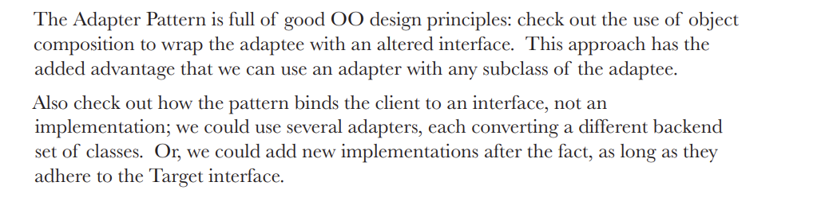

Slide 8
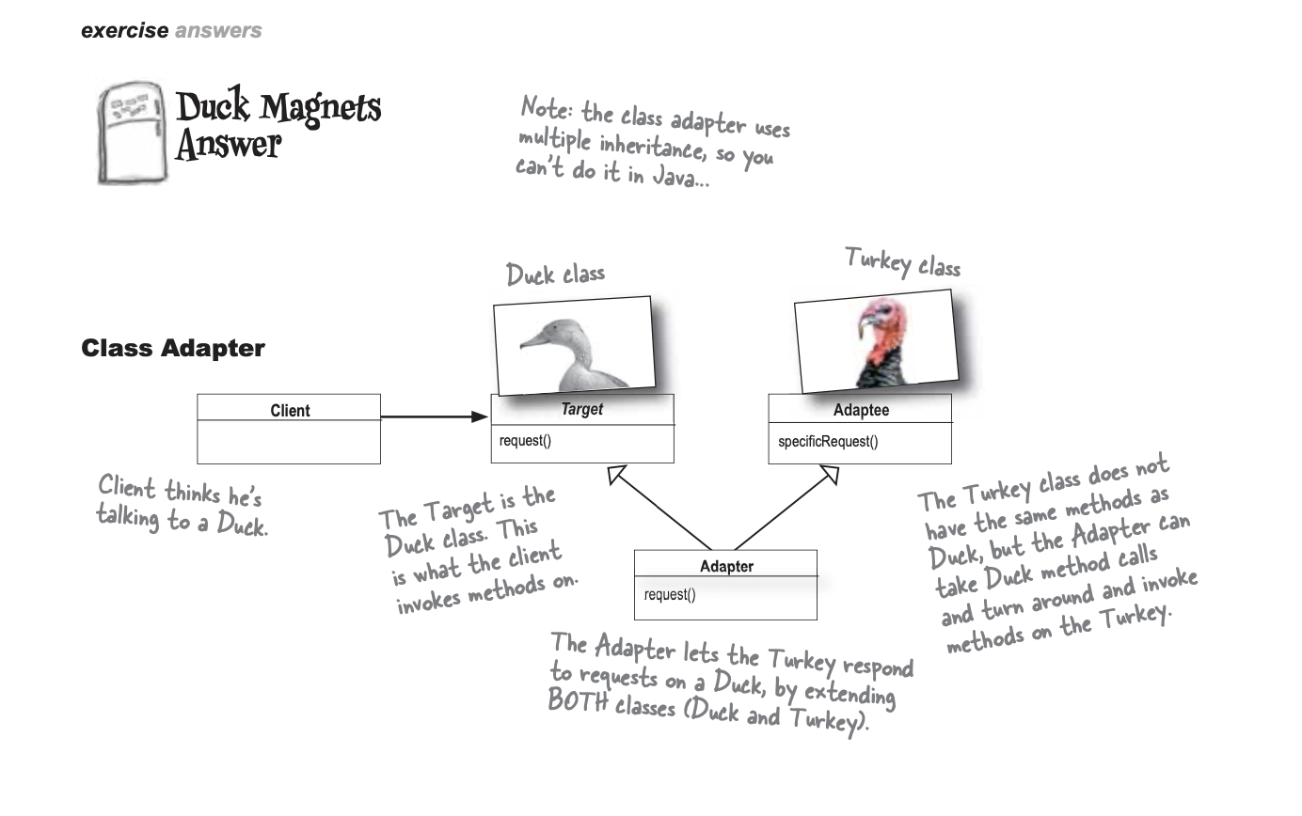

Slide 9
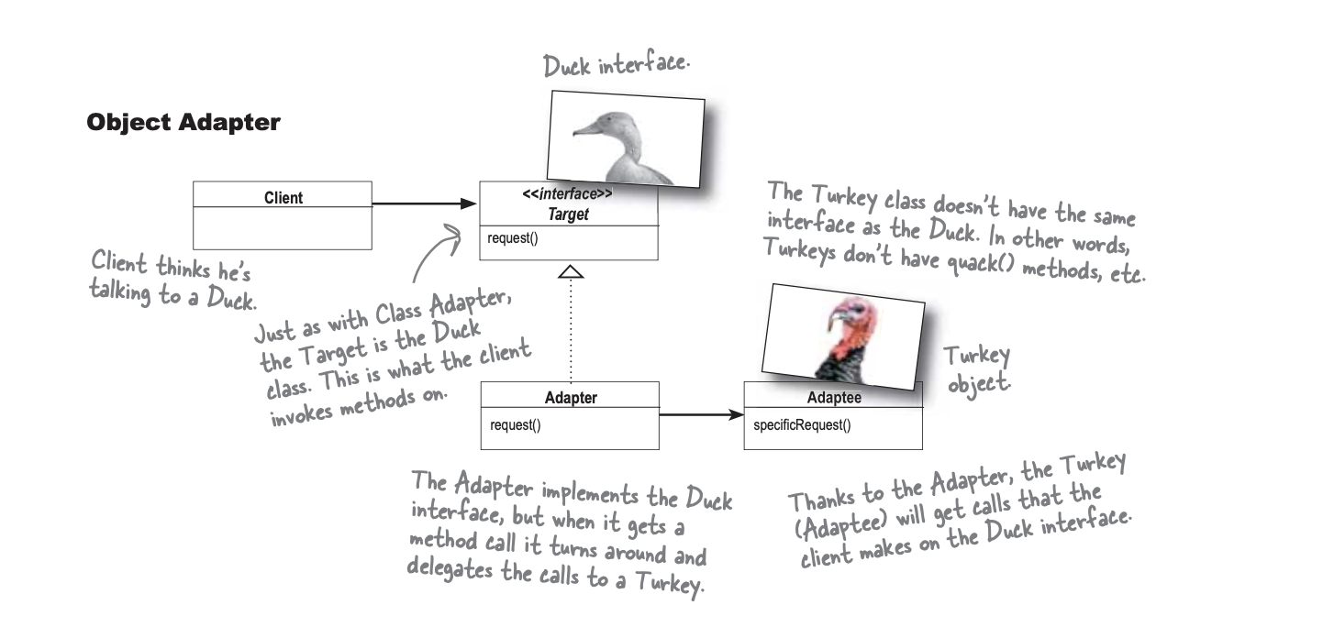

Slide 10
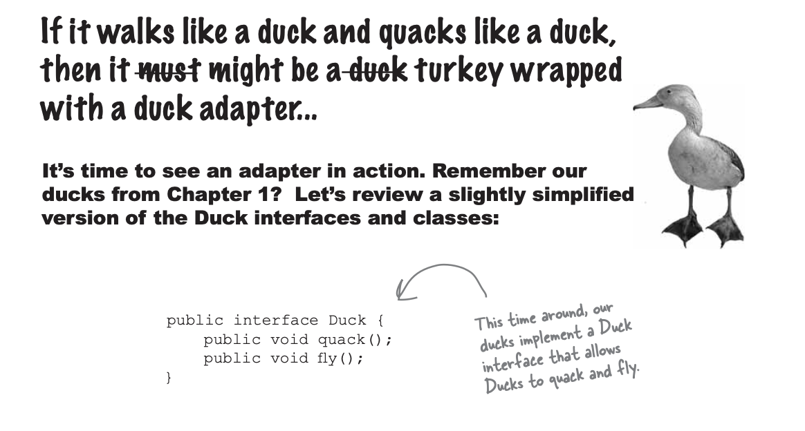

Slide 11
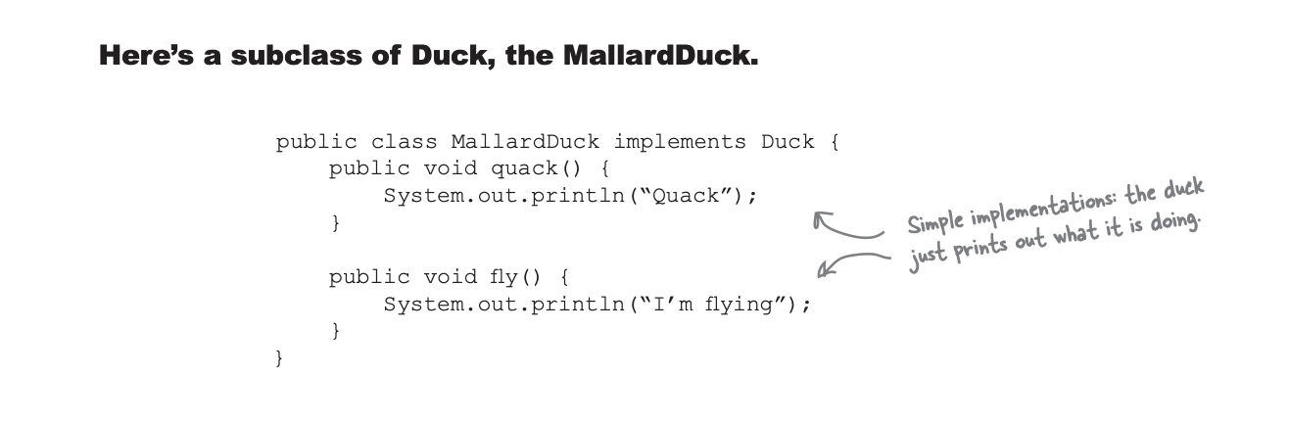

Slide 12
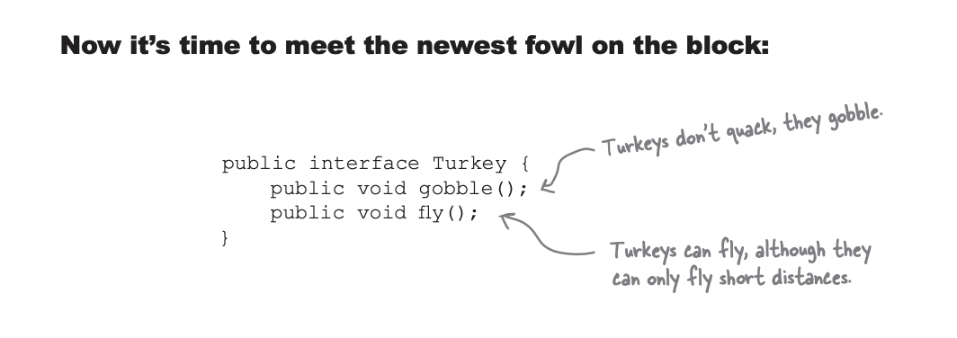

Slide 13
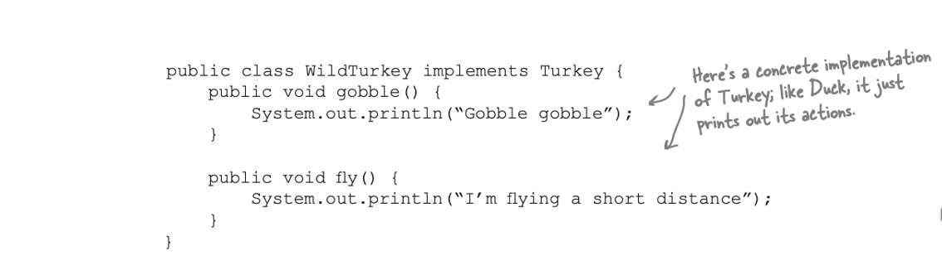

Slide 14
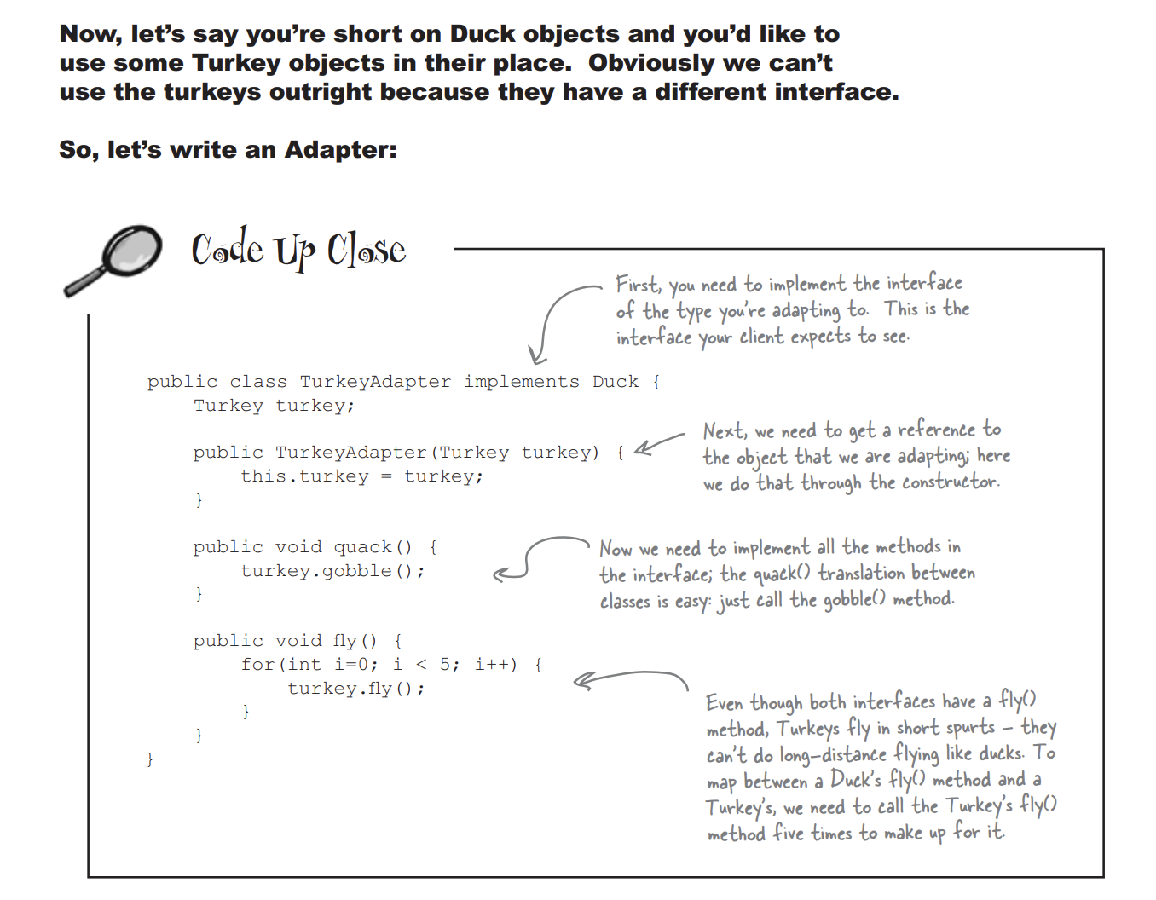

Slide 15
